Slide 1

House Price Prediction
Submitted By : Vaibhav Khera (356)

Slide 2
INTRODUCTION
For many people, buying a property is one of the most important decision and purchase in life. Besides the affordability of a house, other factors such as the desirability of the location also affect the decision-making process.
Researching how much the house you are interested in is worth on your own can be difﬁcult for multiple reasons. One particular reason is that there many factors that inﬂuence the potential price of a house, making it more complicated for an individual to decide how much a house is worth on their own without external help.
This can lead to people making poorly informed decisions whether to buy houses and which price is reasonable. Because houses are long term investments, it is imperative that people make their decisions with the most accurate information possible
When a buyer looks to buy a house, he/she is often made to pay higher prices than what it really costs, and unknowingly they fall for it. A good housing price prediction would better prepare them for what to expect before they make one of the most important ﬁnancial decisions in their lives.
Thus, we need a system which analysis the factors on which the price of a house depends and which based on such factors predicts the accurate price of the house according to buyer’s configuration.

Slide 3
OBJECTIVE
The developed system helps in predicting the house price. The main objectives of our project are: -
Management of house prices faster and easier at one place: By using of this software one can easily get the price of house which he/she wants to buys or sells at the suitable requirements.
Customers satisfaction: One can directly go through to our website for checking the estimate of house price.
Unbiased Results: As the users won’t be cheated by the buyer or seller.

Slide 4
METHODOLOGY
To Extract knowledge from dataset available, we followed the KDD (Knowledge Discovery Process) approach
This process includes the following stages: 1. Data collection 2. Data selection (Dependent, Independent Variables) 3. Data pre-processing (Remove missing values, convert text into numbers) 4. Data transformation (Scale all the factors/variables on a common scale between 0 - 1) 5. Data interpretation and Evaluation (generate graphs of the values and identify possible reasons for the facts)
Knowledge (Logic/Mathematical equation/formula) is acquired! Using this knowledge machine can perform prediction/forecasting/machine learning.

Slide 5
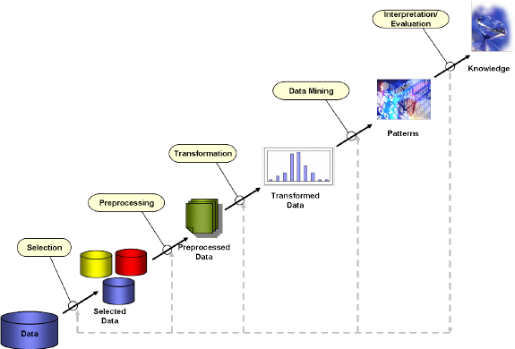
KDD (Knowledge Discovery Process)
Fig-01: KDD Process Diagram

Slide 6
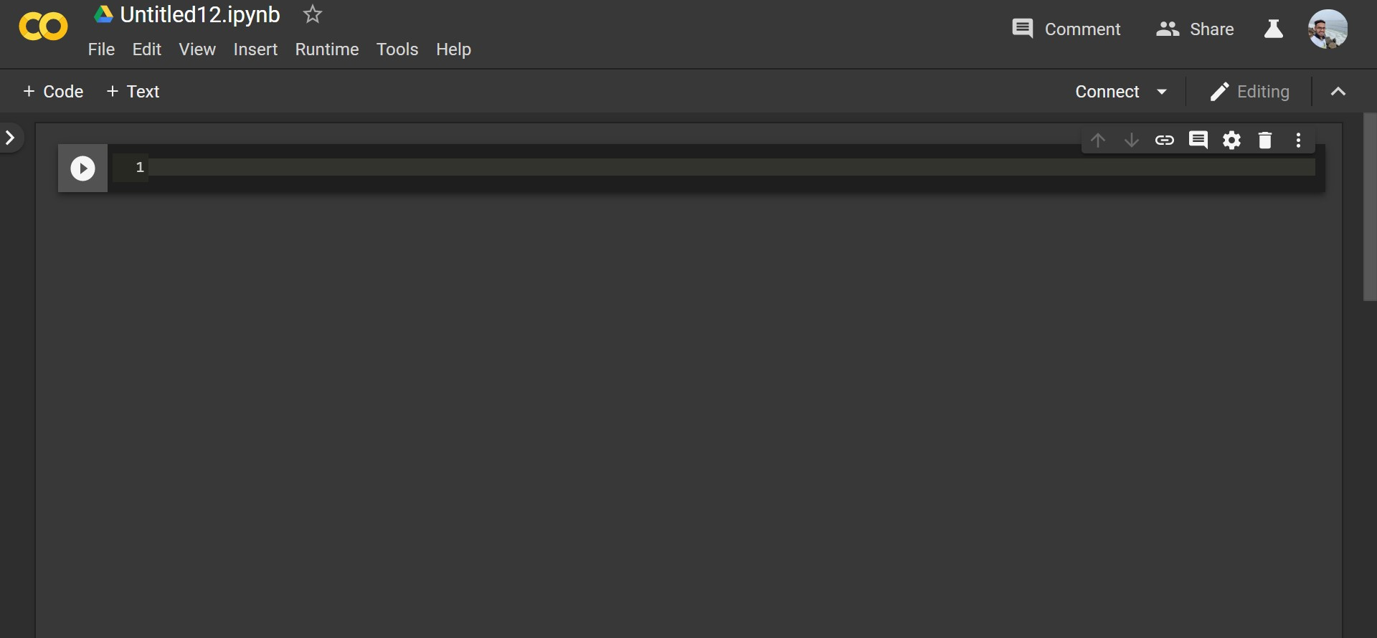
Tools
Colaboratory (also known as Colab) is a free Jupyter notebook environment that requires no setup and runs entirely in the cloud. Colab notebooks are Jupyter notebooks that are hosted by Colab.
With Colaboratory you can write and execute code, save and share your analyses, and access powerful computing resources, all for free from your browser.
When you create your own Colab notebooks, they are stored in your Google Drive account. You can easily share your Colab notebooks with co-workers or friends, allowing them to comment on your notebooks or even edit them.
Colaboratory is a free Jupyter notebook environment provided by Google where you can use free GPUs and TPUs. It’s a Jupyter notebook environment that requires no setup to use.
Fig-02: Layout of Google Colab

Slide 7
Libraries
Pandas is an open source, BSD-licensed library providing high-performance, easy-to-use data structures and data analysis tools for the python programming language.
Pandas is mainly used for Machine Learning in form of data frames. Pandas allow importing data of various file formats such as csv, excel etc. Pandas allows various data manipulation operations such as groupby, join, merge, melt, concatenation as well as data cleaning features such as filling, replacing or imputing null values.
NumPy enriches the programming language Python with powerful data structures, implementing multi-dimensional arrays and matrices. These data structures guarantee efficient calculations with matrices and arrays.
The core functionality of NumPy is its "ndarray", for n-dimensional array, data structure. These arrays are strided views on memory.
Matplotlib is a Python 2D plotting library which produces publication quality figures in a variety of hardcopy formats and interactive environments across platforms.
Matplotlib is an amazing visualization library in Python for 2D plots of arrays. Matplotlib is a multi-platform data visualization library built on NumPy arrays and designed to work with the broader SciPy stack.

Slide 8
Libraries
Scikit-learn (formerly scikits.learn) is a free software machine learning library for the Python programming language.
It features various classification, regression and clustering algorithms including support vector machines, random forests, gradient boosting, k-means and DBSCAN, and is designed to interoperate with the Python numerical and scientific libraries NumPy and SciPy. Simple and efficient tools for data mining and data analysis.
Accessible to everybody, and reusable in various contexts
Built on NumPy, SciPy, and matplotlib
Open source, commercially usable - BSD license
Classification - Identifying to which category an object belongs to.
Regression - Predicting a continuous-valued attribute associated with an object.
Clustering- Automatic grouping of similar objects into sets.

Slide 9
Dataset
Dataset is the most important step for solving any Machine Learning problem. The dataset we used is “Housing_Modified.csv”, which consists of Price of house and the various factors that affect the price.
The dataset is maintained in a CSV File(Comma Separated Values) and we use this file to perform analysis of the data.
Columns of the dataset are:
price (in USD)
lotsize (in Sq. Metres)
bedrooms (No. of bedrooms -1, 2,3..)
bathrms (No. of bathrooms -1, 2,..)
stories (Categorial values like One,Two,Three..)
driveway (Binary Categorical values like yes/no)
recroom (Binary Categorical values like yes/no)
fullbase (Binary Categorical values like yes/no)
gashw (Binary Categorical values like yes/no)
airco (Binary Categorical values like yes/no)
garagepl (No. of garage place -0,1, 2)
prefarea (Binary Categorical values like yes/no)

Slide 10
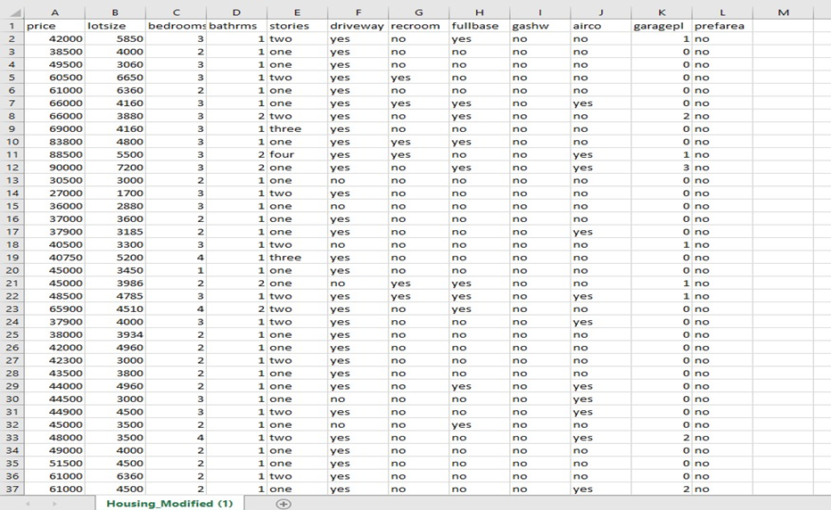
Dataset
Fig-03: Example of Dataset

Slide 11
Dependent and Independent variables
Out of all the information available to us, we have identiﬁed relevant features to be used in our prediction model, as we believe these variables contribute to the price of a house.
Independent Variables | Dependent Variable
lotsize (in Sq. Metres) bedrooms (No. of bedrooms -1, 2,3..) bathrms (No. of bathrooms -1, 2,..) stories (Categorial values like One,Two,Three..) driveway (Binary Categorical values like yes/no) recroom (Binary Categorical values like yes/no) fullbase (Binary Categorical values like yes/no) gashw (Binary Categorical values like yes/no) airco (Binary Categorical values like yes/no) garagepl (No. of garage place -0,1, 2) prefarea (Binary Categorical values like yes/no) | price (in USD)
Table-01: Dependent And Independent Variable

Slide 12
Data Description
In this dataset, there are 546 rows and 12 columns. The columns contain the factors on which the price of the house depends.
Some columns contain numeric values while others contain binary categorical values and thus, needs to be converted into numerical characters to evaluate the dataset, as the regression techniques only work on numerical data.
Columns with Numerical and Binary Data
Numerical Data | Binary Data
price (in USD) lotsize (in Sq. Metres) bedrooms (No. of bedrooms -1, 2,3..) bathrms (No. of bathrooms -1, 2,..) garagepl (No. of garage place -0,1, 2) | driveway (Binary Categorical values like yes/no) recroom (Binary Categorical values like yes/no) fullbase (Binary Categorical values like yes/no) gashw (Binary Categorical values like yes/no) airco (Binary Categorical values like yes/no) prefarea (Binary Categorical values like yes/no)
Table-02: Numerical And Binary Data

Slide 13
Data Visualization and Pre-processing
Data Visualization and Data Analysis is the most crucial part before proceeding further in manipulating data in a number of different ways, such as plotting it out and finding correlations or by creating a pivot table in Excel or Tableau. A pivot table lets you sort and filter data by different variables and lets you calculate the mean, maximum, minimum and standard deviation of your data.
Pre-Processing of data is also the essential part, in which the data is pre-processed on the selection of features which are useful and delete features which are not useful by analysing though plotting graphs and histograms. The pre-processing of data like finding mean, median, mode etc and generate new useful feature columns depending on given feature columns. Also, here is handling of missing Data
The pre-processing of data will help in making feature columns useful which can be used in Deep learning and Machine Learning models. The main objective is to find or arrange data in such a manner that there is some pattern observed in data

Slide 14
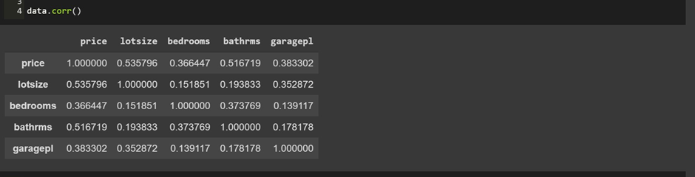
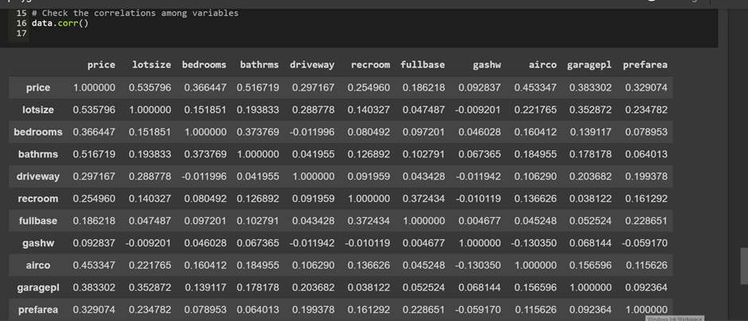
Fig-04: Visualization of data by determining the correlation between the attributes before pre processing. Here we can see that it only contains 5 columns out of 12 as the other columns contains binary categorical values, which were ignored.
Fig-05: Visualization of data after pre-processing. Now when we converted the binary categorical into numerical values and then find the correlation among the variables we get all the 12 columns instead of just 5.

Slide 15
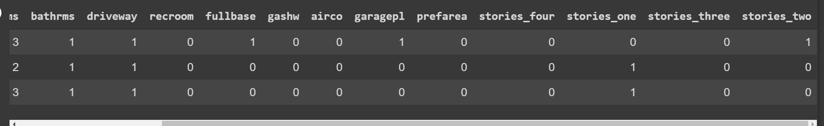
One Hot Encoding
One hot encoding is a process by which categorical variables are converted into a form that could be provided to ML algorithms to do a better job in prediction.
It refers to splitting the column which contains numerical categorical data to many columns depending on the number of categories present in that column. Each column contains “0” or “1” corresponding to which column it has been placed.
Fig-06: One Hot Encoding

Slide 16
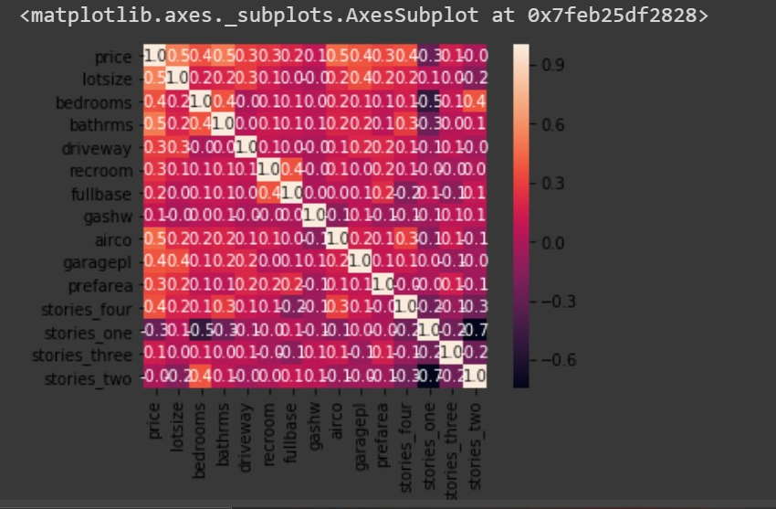
Generation of Heatmap
Create a correlation matrix or a heatmap visual correlation computation.
A heatmap is a two-dimensional graphical representation of data where the individual values that are contained in a matrix are represented as colors.
The seaborn python package allows the creation of annotated heatmaps which can be tweaked using Matplotlib tools as per the creator’s requirement.
Thumb rule is, for a value greater than 0.5 there is a correlation among independent variables.
Fig-07: Heatmap

Slide 17
Multivariate Regression
Multivariate Regression is a method used to measure the degree at which more than one independent variable (predictors) and more than one dependent variable (responses), are linearly related. The method is broadly used to predict the behavior of the response variables associated to changes in the predictor variables, once a desired degree of relation has been established.
In most of the real world cases there will be more than one independent variables, this concept is called Multivariate Regression.

Slide 18
Multicollinearity and VIF
Multicollinearity exists whenever an independent variable is highly correlated with one or more of the other independent variables in a multiple regression equation. Multicollinearity is a problem because it undermines the statistical significance of an independent variable.
The best regression models are those in which the predictor variables each correlate highly with the dependent (outcome) variable but correlate at most only minimally with each other. Such a model is often called "low noise" and will be statistically robust.
An issue with multicollinearity is that small changes to the input data can lead to large changes in the model. A principal danger of such data redundancy is that of overfitting in regression analysis models.
variance inflation factor(VIF) detects multicollinearity in regression analysis. The VIF estimates how much the variance of a regression coefficient is inflated due to multicollinearity in the model.
In general, a VIF above 10 indicates high correlation and is cause for concern.
A rule of thumb for interpreting the variance inflation factor:
1 = not correlated.
Between 1 and 5 = moderately correlated.
Greater than 5 = highly correlated.

Slide 19
Train_Test_Split
The data we use is usually split into training data and test data. The training set contains a known output and the model learns on this data in order to be generalized to other data later on. We have the test dataset (or subset) in order to test our model’s prediction on this subset.
Split arrays or matrices into random train and test subsets
From Sklearn, sub-library model_selection, we imported the train_test_split so we can, well, split to training and test sets.
Underfitting: A statistical model or a machine learning algorithm is said to have underfitting when it cannot capture the underlying trend of the data. Its occurrence simply means that our model or the algorithm does not fit the data well enough. It usually happens when we have less data to build an accurate model and also when we try to build a linear model with a non-linear data.
Overfitting: A statistical model is said to be overfitted, when we train it with a lot of data (just like fitting ourselves in an oversized pants!). When a model gets trained with so much of data, it starts learning from the noise and inaccurate data entries in our data set. A solution to avoid overfitting is using a linear algorithm if we have linear data.

Slide 20
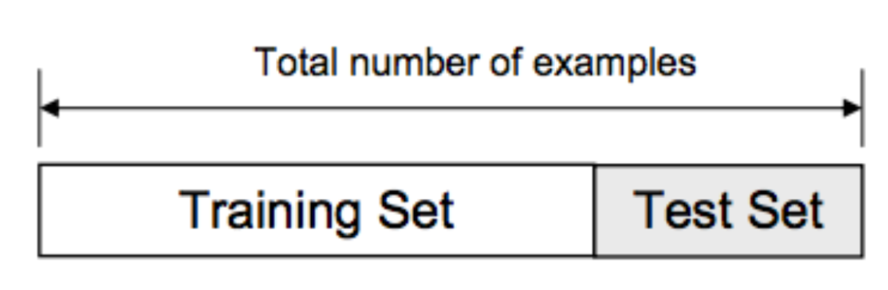

Fig-08: Train_Test_Split And Case of fitting

Slide 21
OLS Model
Ordinary least squares (OLS) regression is a statistical method of analysis that estimates the relationship between one or more independent variables and a dependent variable; the method estimates the relationship by minimizing the sum of the squares in the difference between the observed and predicted values of the dependent variable configured as a straight line.
OLS Model acts as the same way as VIF and helps to determine whether correlation exists between independent variables.
Thumb rule is that : if the probability value is greater than 0.05 then we can say that the variable is highly correlated.

Slide 22
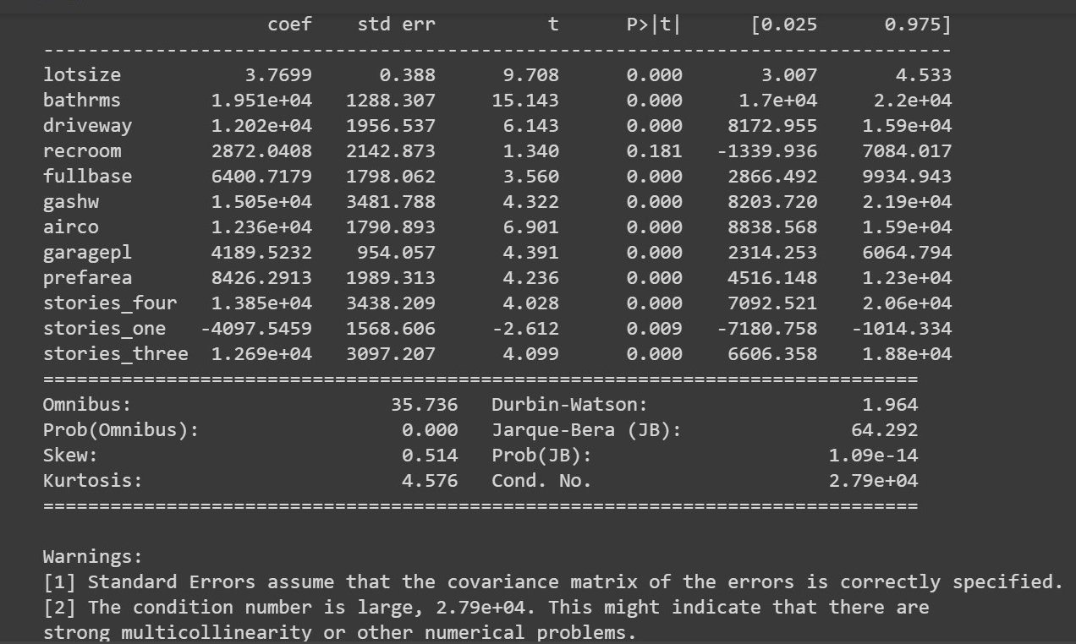
Fig-09 : OLS Model Summary

Slide 23
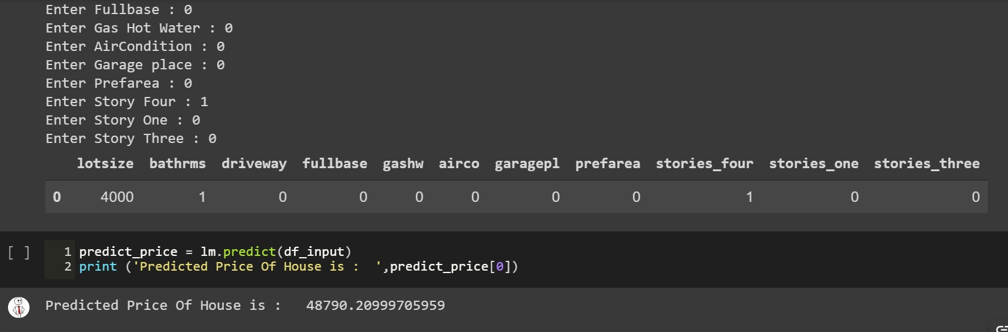
Prediction
model.predict() : given a trained model, predict the label of a new set of data. This method accepts one argument, the new data X_new (e.g. model.predict(X_new)), and returns the learned label for each object in the array.
Basically, when we pass the inputs in the form of an matrix into the predict method, it return linear predicted values from a design matrix.
Fig-10: Predicted Price

Slide 24
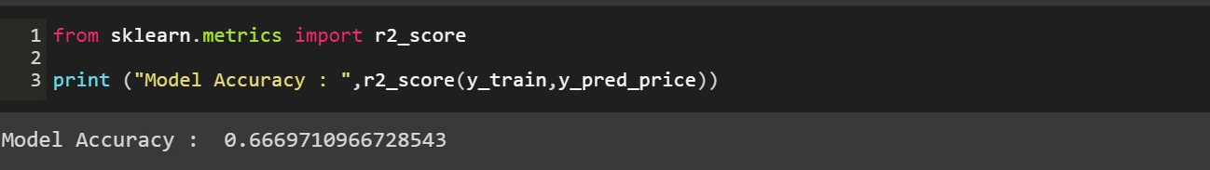
Accuracy
Accuracy is one metric for evaluating classification models. Informally, accuracy is the fraction of predictions our model got right. Formally, accuracy has the following definition:
At this step we compare the original values with the machine generated predicted values, to analyze the accuracy of our model.
We used r2_score to find the accuracy. It is present in sklearn.metrics package
Best possible score is 1.0 and it can be negative. A constant model that always predicts the expected value of y, disregarding the input features, would get a R^2 score of 0.0.

Slide 25
Future Scope
For future work, we were working on large dataset would yield a better and real picture about the model. We have undertaken only few Machine Learning algorithms that are actually classifiers but we need to train many other classifiers and understand their predicting behavior for continuous values too.
By improving the error values this can be useful for development of applications for various respective cities as well. The existing system involves calculation of house prices without the necessary prediction about future market trends and price increase.
To predict the efficient house pricing for real estate customers with respect to their budgets and priorities.

Slide 26
Conclusion
We have used machine learning algorithms to predict the house prices. We have mentioned the step by step procedure to analyze the dataset and finding the correlation between the parameters. Thus we can select the parameters which are not correlated to each other and are independent in nature.
These feature set were then given as an input to four algorithms and a csv file was generated consisting of predicted house prices.
While making the system, an eye has been kept on making it as user-friendly, as cost effective and as flexible as possible. As such one may hope that the system will be acceptable to any user and will adequately meet his/her needs.

Slide 27
References
i. www.w3schools.com
ii. http://stackoverflow.com/
iii. http://www.tutorialspoint.com/asp.net/
iv. https://console.cloud.google.com
v. https://Hackveda.in
vi. https://Wikipedia.com
vii.https://Python.org

Slide 28
Thank You!

